Slide 1
Possible Number Talk Sequence for K-7 Blending Conceptual Understanding, Reasoning and Procedural Fluency
Number Talks
Assembled by Ryan Dent with several examples from “Number Talks” by Sherry Parrish

Slide 2
Notes:
How many are there? And how do you know?
Can you find a second way to see it? A third way?
What equation could we write that matches ________’s thinking?
Is this strategy like any of the other strategies that we’ve seen so far? How?

Slide 3
Notes:
How many are there? And how do you know?
Can you find a second way to see it? A third way?
What equation could we write that matches ________’s thinking?
Is this strategy like any of the other strategies that we’ve seen so far? How?

Slide 4
Notes:
Observe – what are the kids doing, what is the teacher doing?
How many are there? And how do you know?
Can you find a second way to see it? A third way?
What equation could we write that matches ________’s thinking?
Is this strategy like any of the other strategies that we’ve seen so far? How?

Slide 5
Notes:
How many are there? And how do you know?
Can you find a second way to see it? A third way?
What equation could we write that matches ________’s thinking?
Is this strategy like any of the other strategies that we’ve seen so far? How?

Slide 7
Notes:
How many are there? And how do you know?
Can you find a second way to see it? A third way?
What equation could we write that matches ________’s thinking?
Is this strategy like any of the other strategies that we’ve seen so far? How?

Slide 8
Notes:
Observe – what are the kids doing, what is the teacher doing?
How many are there? And how do you know?
Can you find a second way to see it? A third way?
What equation could we write that matches ________’s thinking?
Is this strategy like any of the other strategies that we’ve seen so far? How?

Slide 9
Notes:
Observe – what are the kids doing, what is the teacher doing?
How many are there? And how do you know?
Can you find a second way to see it? A third way?
What equation could we write that matches ________’s thinking?
Is this strategy like any of the other strategies that we’ve seen so far? How?

Slide 10
Notes:
Observe – what are the kids doing, what is the teacher doing?
How many are there? And how do you know?
Can you find a second way to see it? A third way?
What equation could we write that matches ________’s thinking?
Is this strategy like any of the other strategies that we’ve seen so far? How?

Slide 11
Notes:
How many are there? And how do you know?
Can you find a second way to see it? A third way?
What equation could we write that matches ________’s thinking?
Is this strategy like any of the other strategies that we’ve seen so far? How?

Slide 13
Notes:
How many are there? And how do you know?
Can you find a second way to see it? A third way?
What equation could we write that matches ________’s thinking?
Is this strategy like any of the other strategies that we’ve seen so far? How?

Slide 14
Notes:
How many are there? And how do you know?
Can you find a second way to see it? A third way?
What equation could we write that matches ________’s thinking?
Is this strategy like any of the other strategies that we’ve seen so far? How?

Slide 15
Notes:
How many are there? And how do you know?
Can you find a second way to see it? A third way?
What equation could we write that matches ________’s thinking?
Is this strategy like any of the other strategies that we’ve seen so far? How?

Slide 16
Notes:
How many are there? And how do you know?
Can you find a second way to see it? A third way?
What equation could we write that matches ________’s thinking?
Is this strategy like any of the other strategies that we’ve seen so far? How?

Slide 17
Notes:
How many are there? And how do you know?
Can you find a second way to see it? A third way?
What equation could we write that matches ________’s thinking?
Is this strategy like any of the other strategies that we’ve seen so far? How?

Slide 18
Notes:
How many are there? And how do you know?
Can you find a second way to see it? A third way?
What equation could we write that matches ________’s thinking?
Is this strategy like any of the other strategies that we’ve seen so far? How?

Slide 20
Notes:
How many are there? And how do you know?
Can you find a second way to see it? A third way?
What equation could we write that matches ________’s thinking?
Is this strategy like any of the other strategies that we’ve seen so far? How?

Slide 21
Notes:
How many are there? And how do you know?
Can you find a second way to see it? A third way?
What equation could we write that matches ________’s thinking?
Is this strategy like any of the other strategies that we’ve seen so far? How?

Slide 22
Notes:
How many are there? And how do you know?
Can you find a second way to see it? A third way?
What equation could we write that matches ________’s thinking?
Is this strategy like any of the other strategies that we’ve seen so far? How?

Slide 23
Notes:
How many are there? And how do you know?
Can you find a second way to see it? A third way?
What equation could we write that matches ________’s thinking?
Is this strategy like any of the other strategies that we’ve seen so far? How?

Slide 24
Notes:
How many are there? And how do you know?
Can you find a second way to see it? A third way?
What equation could we write that matches ________’s thinking?
Is this strategy like any of the other strategies that we’ve seen so far? How?

Slide 25
Notes:
How many are there? And how do you know?
Can you find a second way to see it? A third way?
What equation could we write that matches ________’s thinking?
Is this strategy like any of the other strategies that we’ve seen so far? How?

Slide 27
Notes:
How many are there? And how do you know?
Can you find a second way to see it? A third way?
What equation could we write that matches ________’s thinking?
Is this strategy like any of the other strategies that we’ve seen so far? How?

Slide 28
Notes:
How many are there? And how do you know?
Can you find a second way to see it? A third way?
What equation could we write that matches ________’s thinking?
Is this strategy like any of the other strategies that we’ve seen so far? How?

Slide 29
Notes:
How many are there? And how do you know?
Can you find a second way to see it? A third way?
What equation could we write that matches ________’s thinking?
Is this strategy like any of the other strategies that we’ve seen so far? How?

Slide 30
Notes:
How many are there? And how do you know?
Can you find a second way to see it? A third way?
What equation could we write that matches ________’s thinking?
Is this strategy like any of the other strategies that we’ve seen so far? How?

Slide 31
Notes:
How many are there? And how do you know?
Can you find a second way to see it? A third way?
What equation could we write that matches ________’s thinking?
Is this strategy like any of the other strategies that we’ve seen so far? How?

Slide 32
Notes:
How many are there? And how do you know?
Can you find a second way to see it? A third way?
What equation could we write that matches ________’s thinking?
Is this strategy like any of the other strategies that we’ve seen so far? How?

Slide 33
Notes:
How many are there? And how do you know?
Can you find a second way to see it? A third way?
What equation could we write that matches ________’s thinking?
Is this strategy like any of the other strategies that we’ve seen so far? How?

Slide 34
Notes:
How many are there? And how do you know?
Can you find a second way to see it? A third way?
What equation could we write that matches ________’s thinking?
Is this strategy like any of the other strategies that we’ve seen so far? How?

Slide 35
Notes:
How many are there? And how do you know?
Can you find a second way to see it? A third way?
What equation could we write that matches ________’s thinking?
Is this strategy like any of the other strategies that we’ve seen so far? How?

Slide 36
Notes:
How many are there? And how do you know?
Can you find a second way to see it? A third way?
What equation could we write that matches ________’s thinking?
Is this strategy like any of the other strategies that we’ve seen so far? How?

Slide 37
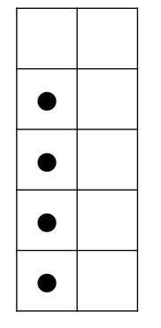
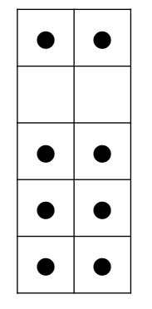
Notes:
How many are there? And how do you know?
What equation could we write that matches ________’s thinking?
Is this strategy like any of the other strategies that we’ve seen so far? How?

Slide 38
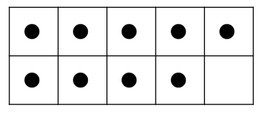
Notes:
How many are there? And how do you know?
What equation could we write that matches ________’s thinking?
Is this strategy like any of the other strategies that we’ve seen so far? How?

Slide 39
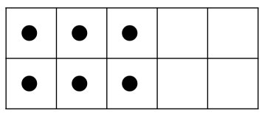
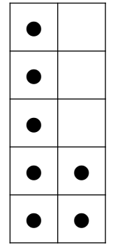
Notes:
How many are there? And how do you know?
What equation could we write that matches ________’s thinking?
Is this strategy like any of the other strategies that we’ve seen so far? How?

Slide 40
Notes:
How many are there? And how do you know?
What equation could we write that matches ________’s thinking?
Is this strategy like any of the other strategies that we’ve seen so far? How?

Slide 41
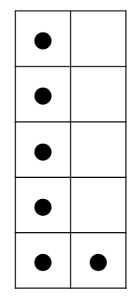
Notes:
How many are there? And how do you know?
What equation could we write that matches ________’s thinking?
Is this strategy like any of the other strategies that we’ve seen so far? How?

Slide 42
6 + 4
6 + 6
6 + 8
6 + 9
Notes:
What did you get?
How did you get it?
Are there any other ways we could think of it?
What could we call that strategy?
Can you use the one we just did to help us with this one?

Slide 43
4 + 4
4 + 3
3 + 3
3 + 4
Notes:
What did you get?
How did you get it?
Are there any other ways we could think of it?
What could we call that strategy?
Can you use the one we just did to help us with this one?

Slide 44
7 + 7
7 + 6
7 + 8
8 + 8
Notes:
What did you get?
How did you get it?
Are there any other ways we could think of it?
What could we call that strategy?
Can you use the one we just did to help us with this one?

Slide 45
8 + 8
8 + 9
9 + 9
9 + 10
Notes:
What did you get?
How did you get it?
Are there any other ways we could think of it?
What could we call that strategy?
Can you use the one we just did to help us with this one?

Slide 46
6 + 4
6 + 4 + 3
6 + 7
6 + 10
Notes:
What did you get?
How did you get it?
Are there any other ways we could think of it?
What could we call that strategy?
Can you use the one we just did to help us with this one?

Slide 47
7 + 3
7 + 5 + 3
3 + 6 + 7
Notes:
What did you get?
How did you get it?
Are there any other ways we could think of it?
What could we call that strategy?
Can you use the one we just did to help us with this one?

Slide 48
4 + 8 + 2 + 6
9 + 3 + 1 + 7
5 + 6 + 5 + 4
Notes:
What did you get?
How did you get it?
Are there any other ways we could think of it?
What could we call that strategy?
Can you use the one we just did to help us with this one?

Slide 49
11 + 11
12 + 12
11 + 12
11 + 10
Notes:
What did you get?
How did you get it?
Are there any other ways we could think of it?
What could we call that strategy?
Can you use the one we just did to help us with this one?

Slide 50
20 + 20
19 + 19
19 + 21
19 + 17
Notes:
What did you get?
How did you get it?
Are there any other ways we could think of it?
What could we call that strategy?
Can you use the one we just did to help us with this one?
What if we started with this last one, which other equations (or string) might help us to get to this last one?

Slide 51
25 + 25
25 + 26
25 + 28
24 + 27
Notes:
What did you get?
How did you get it?
Are there any other ways we could think of it?
What could we call that strategy?
Can you use the one we just did to help us with this one?
What if we started with this last one, which other equations (or string) might help us to get to this last one?

Slide 52
29 + 1
29 + 5
29 + 13
29 + 24
Notes:
What did you get?
How did you get it?
Are there any other ways we could think of it?
What could we call that strategy?
Can you use the one we just did to help us with this one?
What if we started with this last one, which other equations (or string) might help us to get to this last one?

Slide 53
19 + 1
19 + 15
19 + 27
19 + 17
Notes:
What did you get?
How did you get it?
Are there any other ways we could think of it?
What could we call that strategy?
Can you use the one we just did to help us with this one?
What if we started with this last one, which other equations (or string) might help us to get to this last one?

Slide 54
19 + 1
19 + 15
19 + 27
19 + 17
Notes:
What did you get?
How did you get it?
Are there any other ways we could think of it?
What could we call that strategy?
Can you use the one we just did to help us with this one?
What if we started with this last one, which other equations (or string) might help us to get to this last one?

Slide 55
18 + 10
18 + 13
18 + 20
18 + 23
Notes:
What did you get?
How did you get it?
Are there any other ways we could think of it?
What could we call that strategy?
Can you use the one we just did to help us with this one?
What if we started with this last one, which other equations (or string) might help us to get to this last one?

Slide 56
20 - 15
20 - 14
20 - 12
20 - 11
Notes:
What did you get?
How did you get it?
Are there any other ways we could think of it?
What could we call that strategy?
Can you use the one we just did to help us with this one?
What if we started with this last one, which other equations (or string) might help us to get to this last one?

Slide 57
30 - 10
30 - 9
30 - 7
30 - 6
Notes:
What did you get?
How did you get it?
Are there any other ways we could think of it?
What could we call that strategy?
Can you use the one we just did to help us with this one?
What if we started with this last one, which other equations (or string) might help us to get to this last one?

Slide 58
80 – 69
80 – 59
80 – 49
80 - 39
Notes:
What did you get?
How did you get it?
Are there any other ways we could think of it?
What could we call that strategy?
Can you use the one we just did to help us with this one?
What if we started with this last one, which other equations (or string) might help us to get to this last one?

Slide 59
90 – 79
90 – 69
90 – 49
90 - 44
Notes:
What did you get?
How did you get it?
Are there any other ways we could think of it?
What could we call that strategy?
Can you use the one we just did to help us with this one?
What if we started with this last one, which other equations (or string) might help us to get to this last one?

Slide 60
100 – 89
100 – 74
100 – 64
100 - 59
Notes:
What did you get?
How did you get it?
Are there any other ways we could think of it?
What could we call that strategy?
Can you use the one we just did to help us with this one?
What if we started with this last one, which other equations (or string) might help us to get to this last one?

Slide 61
80 – 69
85 – 69
91 – 69
98 - 69
Notes:
What did you get?
How did you get it?
Are there any other ways we could think of it?
What could we call that strategy?
Can you use the one we just did to help us with this one?
What if we started with this last one, which other equations (or string) might help us to get to this last one?

Slide 62
80 – 69
85 – 69
91 – 69
98 - 69
Notes:
What did you get?
How did you get it?
Are there any other ways we could think of it?
What could we call that strategy?
Can you use the one we just did to help us with this one?
What if we started with this last one, which other equations (or string) might help us to get to this last one?

Slide 63
150 – 25
155 – 25
155 – 30
165 - 29
Notes:
What did you get?
How did you get it?
Are there any other ways we could think of it?
What could we call that strategy?
Can you use the one we just did to help us with this one?
What if we started with this last one, which other equations (or string) might help us to get to this last one?

Slide 64
34 – 14
38 – 17
131 - 75
Notes:
What did you get?
How did you get it?
Are there any other ways we could think of it?
What could we call that strategy?
Can you use the one we just did to help us with this one?
What if we started with this last one, which other equations (or string) might help us to get to this last one?

Slide 65
300 – 100
50 – 80
7 – 8
349 - 350
Notes:
What did you get?
How did you get it?
Are there any other ways we could think of it?
What could we call that strategy?
Can you use the one we just did to help us with this one?
What if we started with this last one, which other equations (or string) might help us to get to this last one?

Slide 66
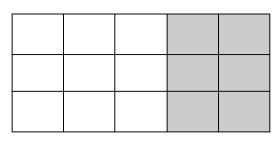

Slide 67
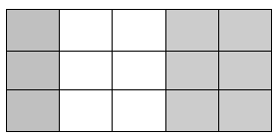

Slide 68
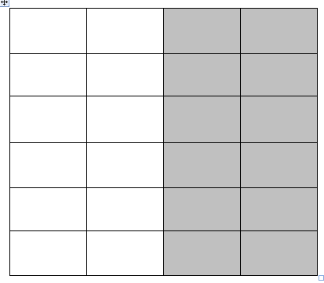

Slide 69
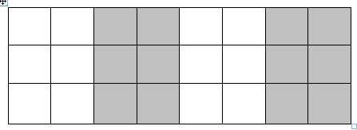

Slide 70
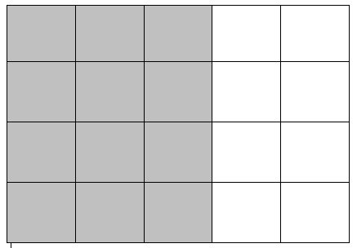

Slide 71
2 x 25
4 x 25
6 x 25
12 x 25
Notes:
What did you get?
How did you get it?
Are there any other ways we could think of it?
What could we call that strategy?
Can you use the one we just did to help us with this one?
What if we started with this last one, which other equations (or string) might help us to get to this last one?

Slide 72
7 x 5
7 x 10
7 x 9
Notes:
What did you get?
How did you get it?
Are there any other ways we could think of it?
What could we call that strategy?
Can you use the one we just did to help us with this one?
What if we started with this last one, which other equations (or string) might help us to get to this last one?

Slide 73
2 x 5
2 x 10
2 x 20
2 x 19
Notes:
What did you get?
How did you get it?
Are there any other ways we could think of it?
What could we call that strategy?
Can you use the one we just did to help us with this one?
What if we started with this last one, which other equations (or string) might help us to get to this last one?

Slide 74
4 x 5
4 x 10
4 x 50
4 x 49
Notes:
What did you get?
How did you get it?
Are there any other ways we could think of it?
What could we call that strategy?
Can you use the one we just did to help us with this one?
What if we started with this last one, which other equations (or string) might help us to get to this last one?

Slide 75
4 x 5
4 x 10
4 x 50
4 x 49
Notes:
What did you get?
How did you get it?
Are there any other ways we could think of it?
What could we call that strategy?
Can you use the one we just did to help us with this one?
What if we started with this last one, which other equations (or string) might help us to get to this last one?

Slide 76
3 x 50
3 x 100
3 x 149
Notes:
What did you get?
How did you get it?
Are there any other ways we could think of it?
What could we call that strategy?
Can you use the one we just did to help us with this one?
What if we started with this last one, which other equations (or string) might help us to get to this last one?

Slide 77
25 x 10
25 x 4
14 x 10
14 x 5
25 x 14
Notes:
What did you get?
How did you get it?
Are there any other ways we could think of it?
What could we call that strategy?
Can you use the one we just did to help us with this one?
What if we started with this last one, which other equations (or string) might help us to get to this last one?

Slide 78
3 x 60
6 x 30
12 x 15
Notes:
What did you get?
How did you get it?
Are there any other ways we could think of it?
What could we call that strategy?
Can you use the one we just did to help us with this one?
What if we started with this last one, which other equations (or string) might help us to get to this last one?

Slide 79
100 x 4
50 x 8
25 x 16
Notes:
What did you get?
How did you get it?
Are there any other ways we could think of it?
What could we call that strategy?
Can you use the one we just did to help us with this one?
What if we started with this last one, which other equations (or string) might help us to get to this last one?

Slide 80
2 x 4 x 35
8 x 5 x 7
8 x 35
Notes:
What did you get?
How did you get it?
Are there any other ways we could think of it?
What could we call that strategy?
Can you use the one we just did to help us with this one?
What if we started with this last one, which other equations (or string) might help us to get to this last one?

Slide 81
4 x 4 x 25
8 x 2 x 25
16 x 5 x 5
16 x 25
Notes:
What did you get?
How did you get it?
Are there any other ways we could think of it?
What could we call that strategy?
Can you use the one we just did to help us with this one?
What if we started with this last one, which other equations (or string) might help us to get to this last one?

Slide 82
40 ÷ 4
16 ÷ 4
56 ÷ 4
Notes:
What did you get?
How did you get it?
Are there any other ways we could think of it?
What could we call that strategy?
Can you use the one we just did to help us with this one?
What if we started with this last one, which other equations (or string) might help us to get to this last one?

Slide 83
40 ÷ 4
24 ÷ 4
67 ÷ 4
Notes:
What did you get?
How did you get it?
Are there any other ways we could think of it?
What could we call that strategy?
Can you use the one we just did to help us with this one?
What if we started with this last one, which other equations (or string) might help us to get to this last one?

Slide 84
30 ÷ 3
18 ÷ 3
48 ÷ 3
Notes:
What did you get?
How did you get it?
Are there any other ways we could think of it?
What could we call that strategy?
Can you use the one we just did to help us with this one?
What if we started with this last one, which other equations (or string) might help us to get to this last one?

Slide 85
50 ÷ 5
30 ÷ 5
80 ÷ 5
Notes:
What did you get?
How did you get it?
Are there any other ways we could think of it?
What could we call that strategy?
Can you use the one we just did to help us with this one?
What if we started with this last one, which other equations (or string) might help us to get to this last one?

Slide 86
100 ÷ 4
200 ÷ 4
40 ÷ 4
16 ÷ 4
256 ÷ 4
Notes:
What did you get?
How did you get it?
Are there any other ways we could think of it?
What could we call that strategy?
Can you use the one we just did to help us with this one?
What if we started with this last one, which other equations (or string) might help us to get to this last one?

Slide 87
4 x 10
4 x 5
4 x 4
56 ÷ 4
Notes:
What did you get?
How did you get it?
Are there any other ways we could think of it?
What could we call that strategy?
Can you use the one we just did to help us with this one?
What if we started with this last one, which other equations (or string) might help us to get to this last one?

Slide 88
6 x 10
6 x 5
6 x 6
6 x 2
99 ÷ 6
Notes:
What did you get?
How did you get it?
Are there any other ways we could think of it?
What could we call that strategy?
Can you use the one we just did to help us with this one?
What if we started with this last one, which other equations (or string) might help us to get to this last one?

Slide 89
6 x 100
6 x 50
6 x 60
6 x 50
536 ÷ 6
Notes:
What did you get?
How did you get it?
Are there any other ways we could think of it?
What could we call that strategy?
Can you use the one we just did to help us with this one?
What if we started with this last one, which other equations (or string) might help us to get to this last one?

Slide 90
100 ÷ 4
200 ÷ 8
400 ÷ 16
Notes:
What did you get?
How did you get it?
Are there any other ways we could think of it?
What could we call that strategy?
Can you use the one we just did to help us with this one?
What if we started with this last one, which other equations (or string) might help us to get to this last one?

